Slide 1
Question 1
Which does a better job showing timeseries data?
A.
B.

Slide 2
Question 1
Which does a better job showing timeseries data?
A.
B.

Slide 3
Question 2
What is the correct sequence of events in a data visualization process?
Production > Refinement > Development
Development > Refinement > Production
Idea > Refinement > Execution
Refinement > Development > Production

Slide 4
Question 2
What is the correct sequence of events in a data visualization process?
Production > Refinement > Development
Development > Refinement > Production
Idea > Refinement > Execution
Refinement > Development > Production

Slide 5
Question 3
Which data visualization type is best used when the analysis is complete, and the visualization exists to support the existing narrative?
Scatter-plot chart
Data graphic
Info graphic
Visual graphic

Slide 6
Question 3
Which data visualization type is best used when the analysis is complete, and the visualization exists to support the existing narrative?
Scatter-plot chart
Data graphic
Info graphic
Visual graphic

Slide 7

Question 4
When elements which share similar characteristics like shape, color, or size will perceived as being part of a group, this describes the following data visualization principle.
Proximity
Laws of Grouping
Continuity
Similarity

Slide 8
Question 4
When elements which share similar characteristics like shape, color, or size will perceived as being part of a group, this describes the following data visualization principle.
Proximity
Laws of Grouping
Continuity
Similarity

Slide 9
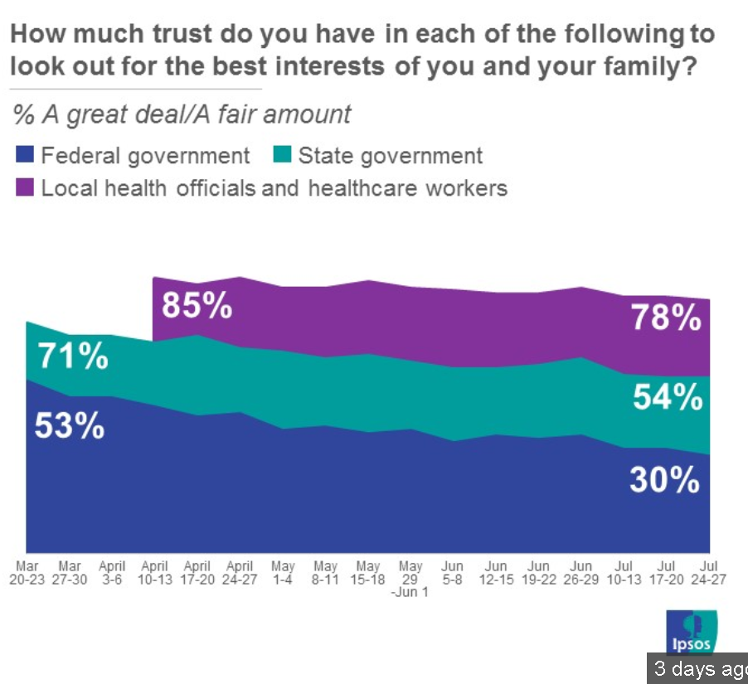
Question 5
What’s wrong with this chart?

Slide 10
Question 5
What’s wrong with this chart?
Unclear scales
Unclear what’s being plotted (is a great deal being divided by a affair amount?)
Layering of charts is not an extension of the underlying data

Slide 11
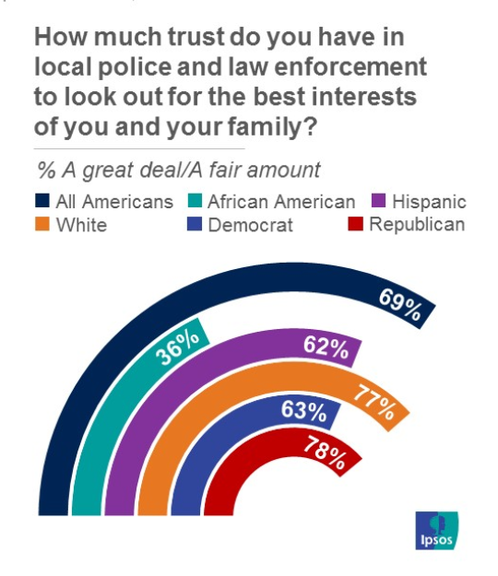
Question 6
Which data visualization principle does this chart violate?
A. Similarity
B. Proximity
C. Continuity
D. Spatial Positioning

Slide 12
Question 6
Which data visualization principle does this chart violate?
A. Similarity
B. Proximity
C. Continuity
D. Spatial Positioning

Slide 13
Question 7
What we present must always be…
The natural extension of the underlying problem
Divorced from the underlying data
An expression of our inner creativity
What management and stakeholders believe is the most important data

Slide 14
Question 7
What we present must always be…
The natural extension of the underlying problem
Divorced from the underlying data
An expression of our inner creativity
What management and stakeholders believe is the most important data

Slide 15
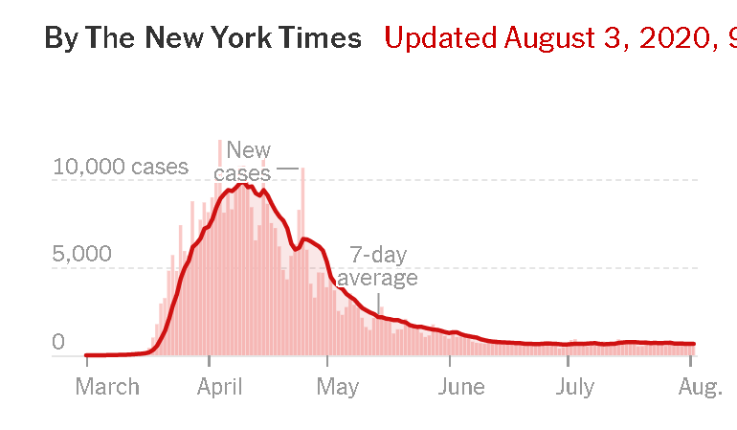
Question 8
This chart is a good example of a(n)
Data plot
Data chart
Info graphic
Data graphic

Slide 16
Question 8
This chart is a good example of a(n)
Data plot
Data chart
Info graphic
Data graphic

Slide 17
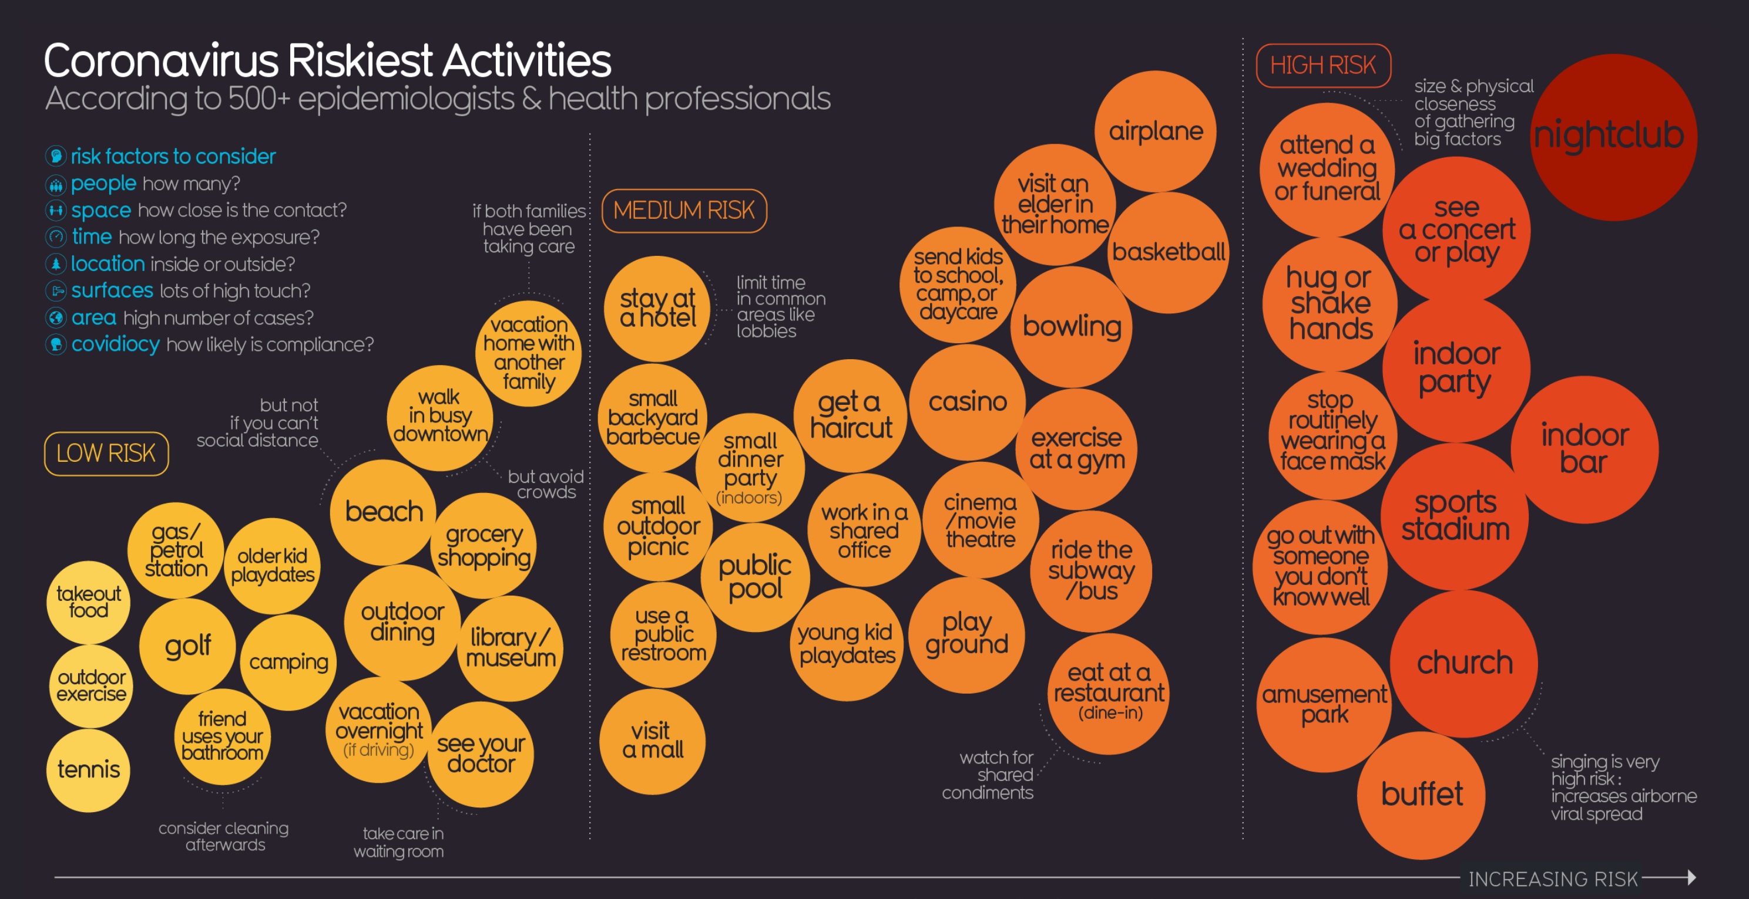
Question 9
The following is a good example of a(n)….
Data plot
Data chart
Info graphic
Data graphic

Slide 18
Question 9
The following is a good example of a(n)….
Data plot
Data chart
Info graphic
Data graphic

Slide 19
Question 10
Which columns in this table have alignment issues?
a. Column 1
b. Columns 1 & 2
c. Columns 1, 2, & 3
d. All of the columns
Column 1
Column 2
Column 3
Column 4
Key Value | Date | Categorical | Numerical
Project 1 | 8/2/1999 | High | $5000.00
Project 2 | 10/23/1999 | Medium | $7000.00
Project 3 | 1/28/2000 | Low | $3000.20
Project 4 | 2/7/2000 | Medium | $500.00

Slide 20
Question 10
Which columns in this table have alignment issues?
a. Column 1
b. Columns 1 & 2
c. Columns 1, 2, & 3
d. All of the columns
Column 1
Column 2
Column 3
Column 4
Key Value | Date | Categorical | Numerical
Project 1 | 8/2/1999 | High | $5000.00
Project 2 | 10/23/1999 | Medium | $7000.00
Project 3 | 1/28/2000 | Low | $3000.20
Project 4 | 2/7/2000 | Medium | $500.00

Slide 21
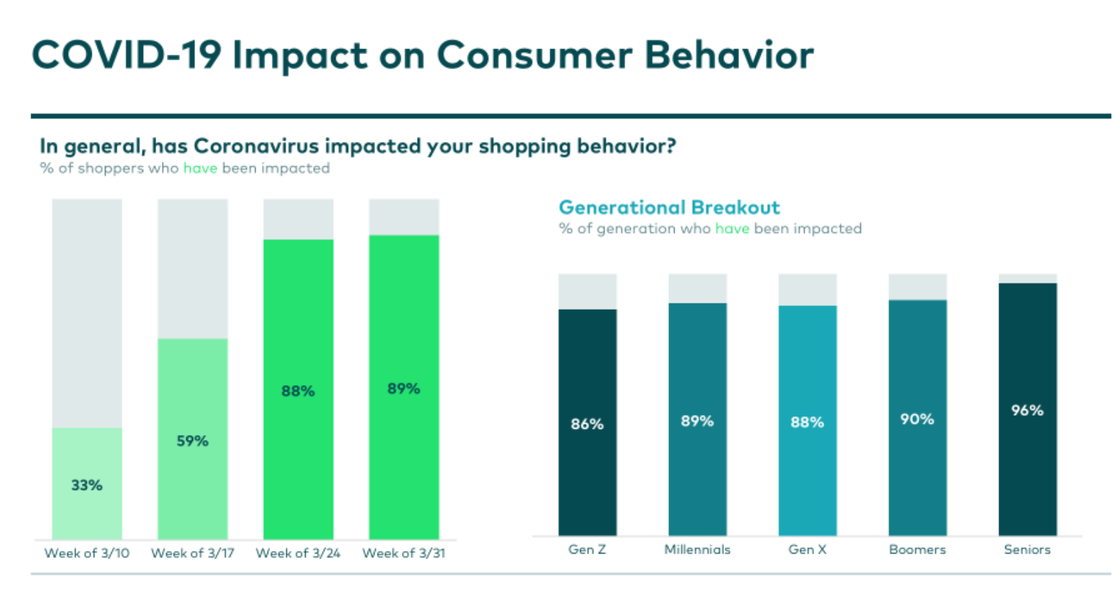
Question 11
Critique these charts,…

